Slide 1



AGE 214: Lecture 9
BJT Configurations & Characteristics
Sokoine University of Agriculture
AGE 214 - Lecture 9

Slide 2


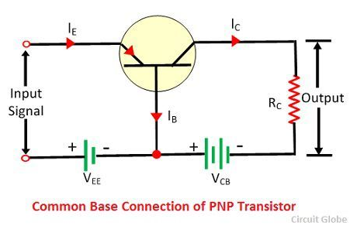
Introduction to Configurations
The 3-Terminal Problem
A BJT has 3 terminals (Emitter, Base, Collector). However, any circuit requires 2 ports (Input & Output), which needs 4 terminals.
Solution: One terminal is made Common to both input and output (Grounded). This gives us three distinct modes of operation.
•
Common Base (CB)
•
Common Emitter (CE)
•
Common Collector (CC)
Sokoine University of Agriculture
AGE 214 - Lecture 9

Slide 3

Common Base Configuration
Features
•
Common Terminal: Base (Grounded).
•
Input: Emitter.
•
Output: Collector.
•
Current Gain: Alpha (α) < 1.
•
Voltage Gain: High.
•
Usage: High-frequency applications (Radio RF amps) due to low input capacitance.
Sokoine University of Agriculture
AGE 214 - Lecture 9

Slide 4
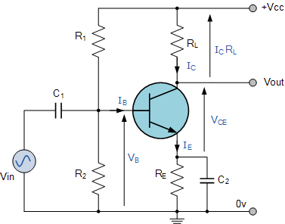
Common Emitter Configuration
The Amplifier Standard
This is the most widely used configuration.
•
Common Terminal: Emitter (Grounded).
•
Input: Base.
•
Output: Collector.
•
Phase Shift: 180° (Input High → Output Low).
•
Power Gain: Very High (Both Voltage and Current gain).
Sokoine University of Agriculture
AGE 214 - Lecture 9

Slide 5
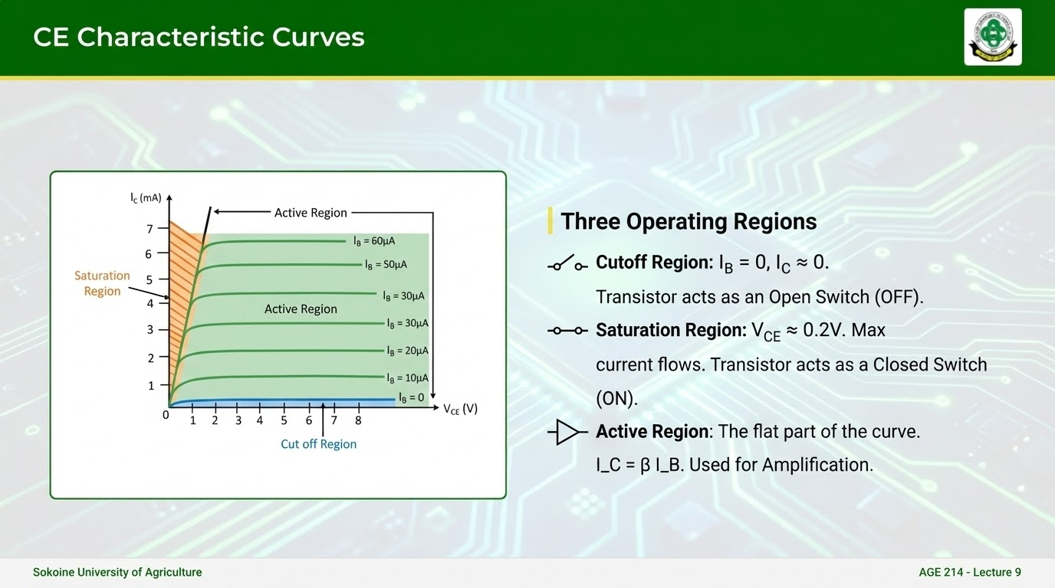

Slide 6
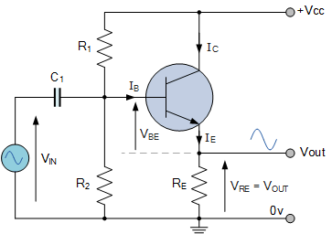
Common Collector (Emitter Follower)
Features
•
Common Terminal: Collector.
•
Input: Base.
•
Output: Emitter (Follows the base voltage).
•
Voltage Gain: Unity (~1).
•
Impedance: High Input Z, Low Output Z.
•
Use: Buffer / Impedance Matching.
Sokoine University of Agriculture
AGE 214 - Lecture 9

Slide 7
Comparison Summary
Parameter | Common Base | Common Emitter | Common Collector
Input Z | Very Low | Medium | High
Output Z | Very High | Medium | Low
Voltage Gain | High | Medium | Low (~1)
Current Gain | Low (< 1) | High ($\beta$) | High ($\beta + 1$)
Phase Shift | 0° | 180° | 0°
Sokoine University of Agriculture
AGE 214 - Lecture 9

Slide 8
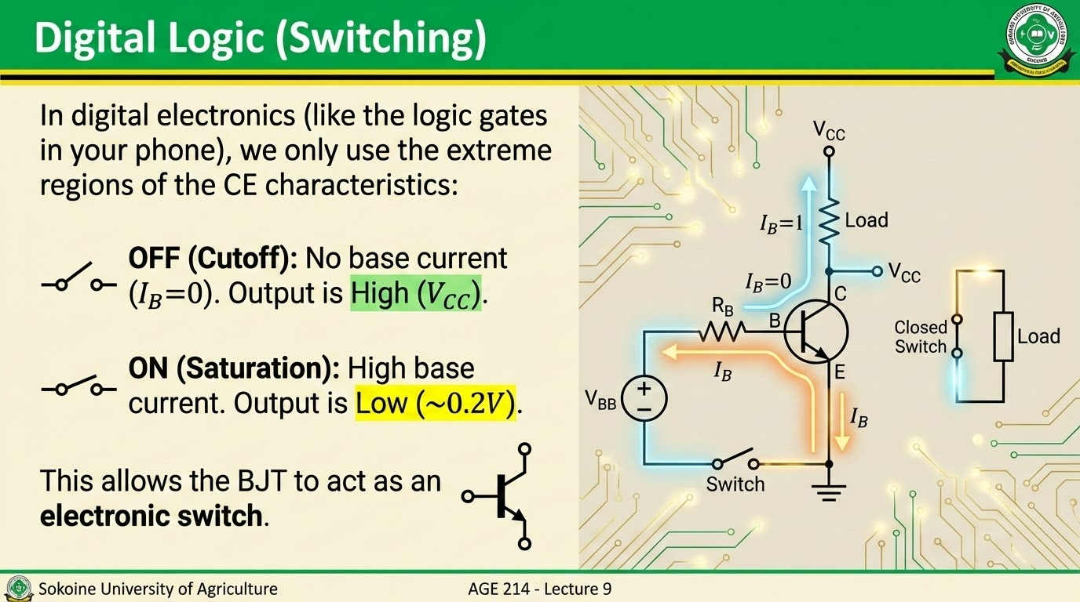

Slide 9
Questions?
Next Lecture: BJT DC Biasing Techniques
Dr. Kadeghe Fue
Sokoine University of Agriculture
AGE 214 - Lecture 9

Slide 10






Image Sources
https://upload.wikimedia.org/wikipedia/en/c/c1/SUA.png
Source: wikipedia.org
https://circuitglobe.com/wp-content/uploads/2017/05/cokmon-base-pnp-transistor.jpg
Source: circuitglobe.com
https://www.electronics-tutorials.ws/wp-content/uploads/2013/07/amp5.gif?fit=377%2C296
Source: www.electronics-tutorials.ws
https://i.sstatic.net/avBhN.jpg
Source: electronics.stackexchange.com
https://www.electronics-tutorials.ws/wp-content/uploads/2019/02/amp113.gif
Source: www.electronics-tutorials.ws
https://www.build-electronic-circuits.com/wp-content/uploads/2023/10/sw_gift-3.gif
Source: www.build-electronic-circuits.com

